Slide 1
The Ambient Sole
Jessica Handloff, Sarah Evans, and Geoffrey Luurs

Slide 2
Abstract
"The Ambient Sole" is a digital project that invites users to engage with the world that surround them. As human lives become busier and busier, the simple mechanical processes of our ambient environment fade into the subconscious only to be recalled during a disrupting or uncanny experience. "The Ambient Sole" seeks to cause these disruptions by adding sound to the footstep, taking away its quotidian properties and calling one's surroundings into the forefront of consciousness. As users step onto this mat, they are entering into a rhetoric of spaces where they are allowed to shape their environment just as much as their environment shapes them. Using this simple kit, users will be able to create a non-descript floormat that is programmable with up to 12 MP3s to create unique and fun experiences for all who walk past. This kit is designed so that even the most novice of users can create a working mat by assembling the pieces, and loading their preferred sounds into the onboard MP3 player. In just a short amount of time, all users can engage with the souls of their shoes.

Slide 3
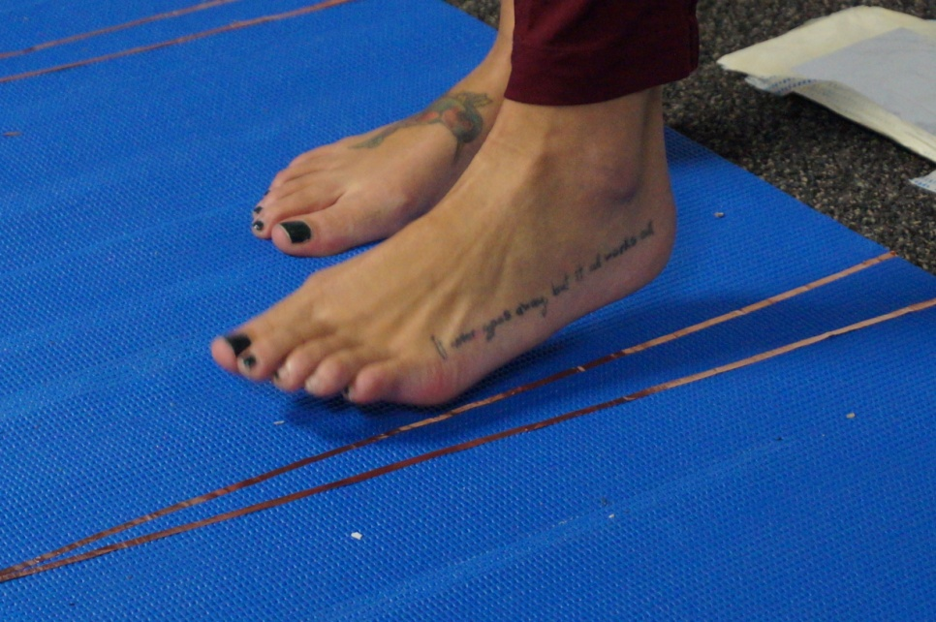
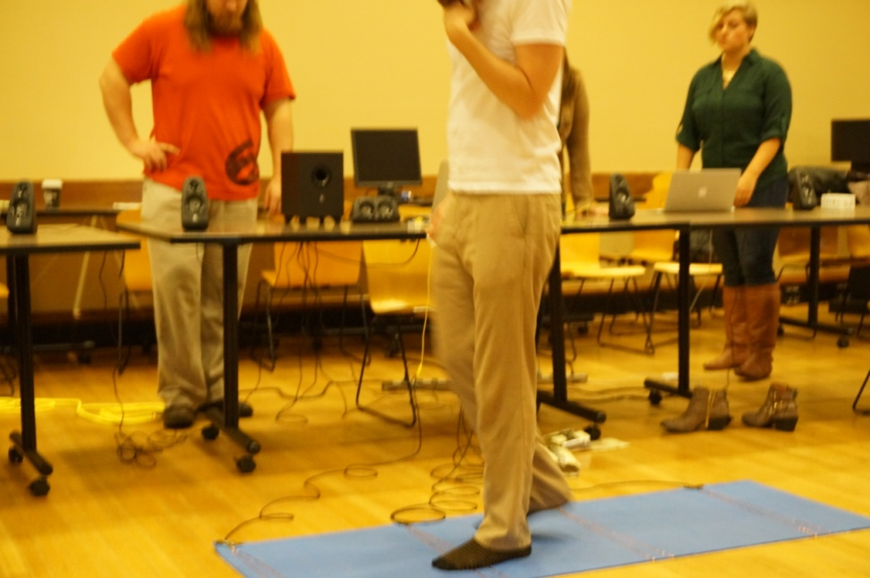
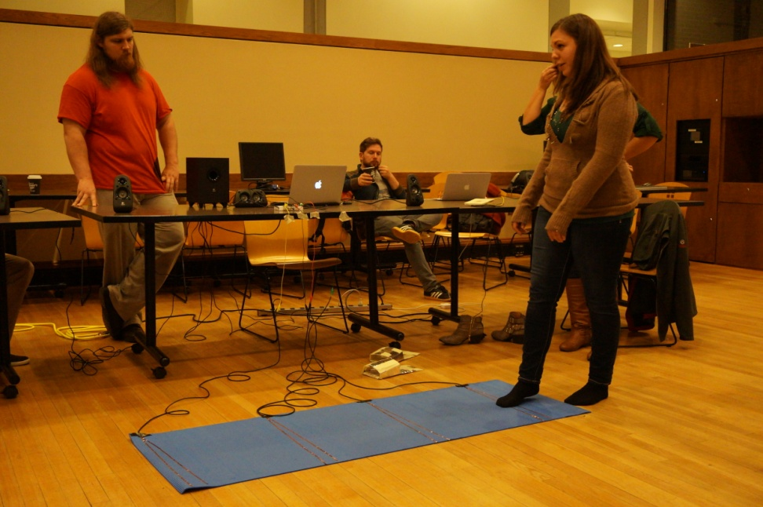
“The Ambient Sole”

Slide 4
Needed materials
Floor mat/Rug – Any size is suitable for the project but a longer mat allows for more footsteps per participant
Bare Conductive brand Touch Board with Arduino capability
Polythylene anti-static foam
Copper tape
Electrical tape
Shielded three-stranded antenna wire
Aluminum foil
Cardboard

Slide 5
Assembly Directions
Step 1: On the underside of the mat, place strips of copper tape at random desired intervals. There should be one strip of copper tape per sound you wish to utilize. Note: The code will prevent sounds from triggering if multiple sensors are pushed, so spread the copper tape so that there are blank spaces in which people can step.

Slide 6
Step 1 Example

Slide 7
Step 1 Example

Slide 8
Assembly Directions
Step 2: Cut shielded wire to desired length. We recommended running the wires so that they bunch at one end and disappear off to the side so as to draw less attention.
Step 3: Strip about 1" off the end of the wire and tape it to the copper strips. Each copper strip will require a separate wire.

Slide 9
Assembly Directions
Step 4: Attach wires to Bare Conductive Touch Board. Soldering will provide the cleanest connection, however, alligator clips provide flexibility if you want to house the Touch Board and wires inconspicuously.
Step 5: Cut out rectangles of anti-static foam to provide coverage across the mat. You will want to create holes for your pressure sensors but also want to have near uniform coverage so that walking across the mat provides a smooth experience.

Slide 10
Step 5 Example

Slide 11
Assembly Directions
Step 6: Cut apart the cardboard box that this kit arrived in to fit the holes your created in step 5. These will be used to make pressure sensors that expand the coverage area of your copper tape. You will want the cardboard to be slightly larger than the hole so that the anti-static foam acts as a buffer between the copper tape and pressure plate when it is not being stepped on.

Slide 12
Assembly Directions
Step 7: Cover one side of each cardboard cutout with aluminum foil and tape the foil to the cardboard to secure it. These are now your pressure plates.
Step 8: Place the pressure plate over the hole and tape it to secure it in place.

Slide 13
Assembly Directions
Step 9: You have now fully constructed the mat. Flip it over and do your best to bunch the wires so that you may hide them off to the side. Because this mat is meant for public settings, one bunch of wires is less likely to raise suspicion than 12 single wires going off to the side.
Step 10: Select the MP3 files of your choice and upload them to the SD card along with the Arduino code provided in this kit. We suggest having short bursts of sounds (1 second or less) because of the pace at which people will walk across the mat.

Slide 14
Assembly Directions
Step 11: Turn on the touchboard and enjoy "The Ambient Sole." Note: The Bare Conductive Touch Board can be powered by a Lithium Ion or a Lithium Polymer cell (3.7V) battery. Additionally, you can use a micro USB to connect it to your computer.

